Slide 1
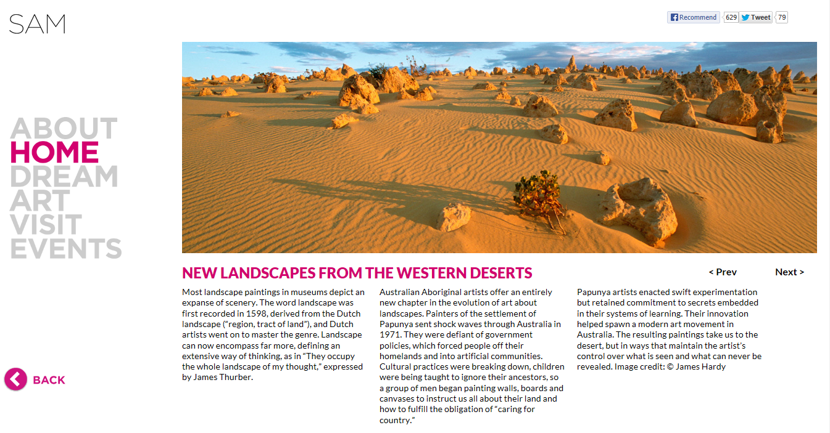
Seattle Art Museum
The Challenge
Seattle Art Museum needed a way to produce a digitally creative platform to showcase their summer Aboriginal Art Exhibit. The goal was to draw visitors to SAM by launching a site that was as unique and captivating as the exhibit itself.
What We Did
Affirma stepped in to create a stunning user experience based on parallax scrolling, a technique which allows the user to seamlessly transition between pages while maintaining the semblance of single page feel.
Results
The result was a site which was highly captivating through its use of the parallax design accompanied by an intuitive user interface. Visitors to the site are able to smoothly navigate between exhibit information, historical facts, and highly detailed images of aboriginal artifacts without interrupting their overall experience.

